Slide 1


Radio Tomographic Imaging Stage 1---- Data Collection
Yan Bingtao
Advisor: Dr. Ram Sundaram

Slide 2
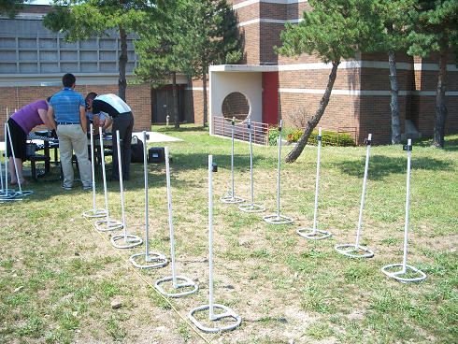
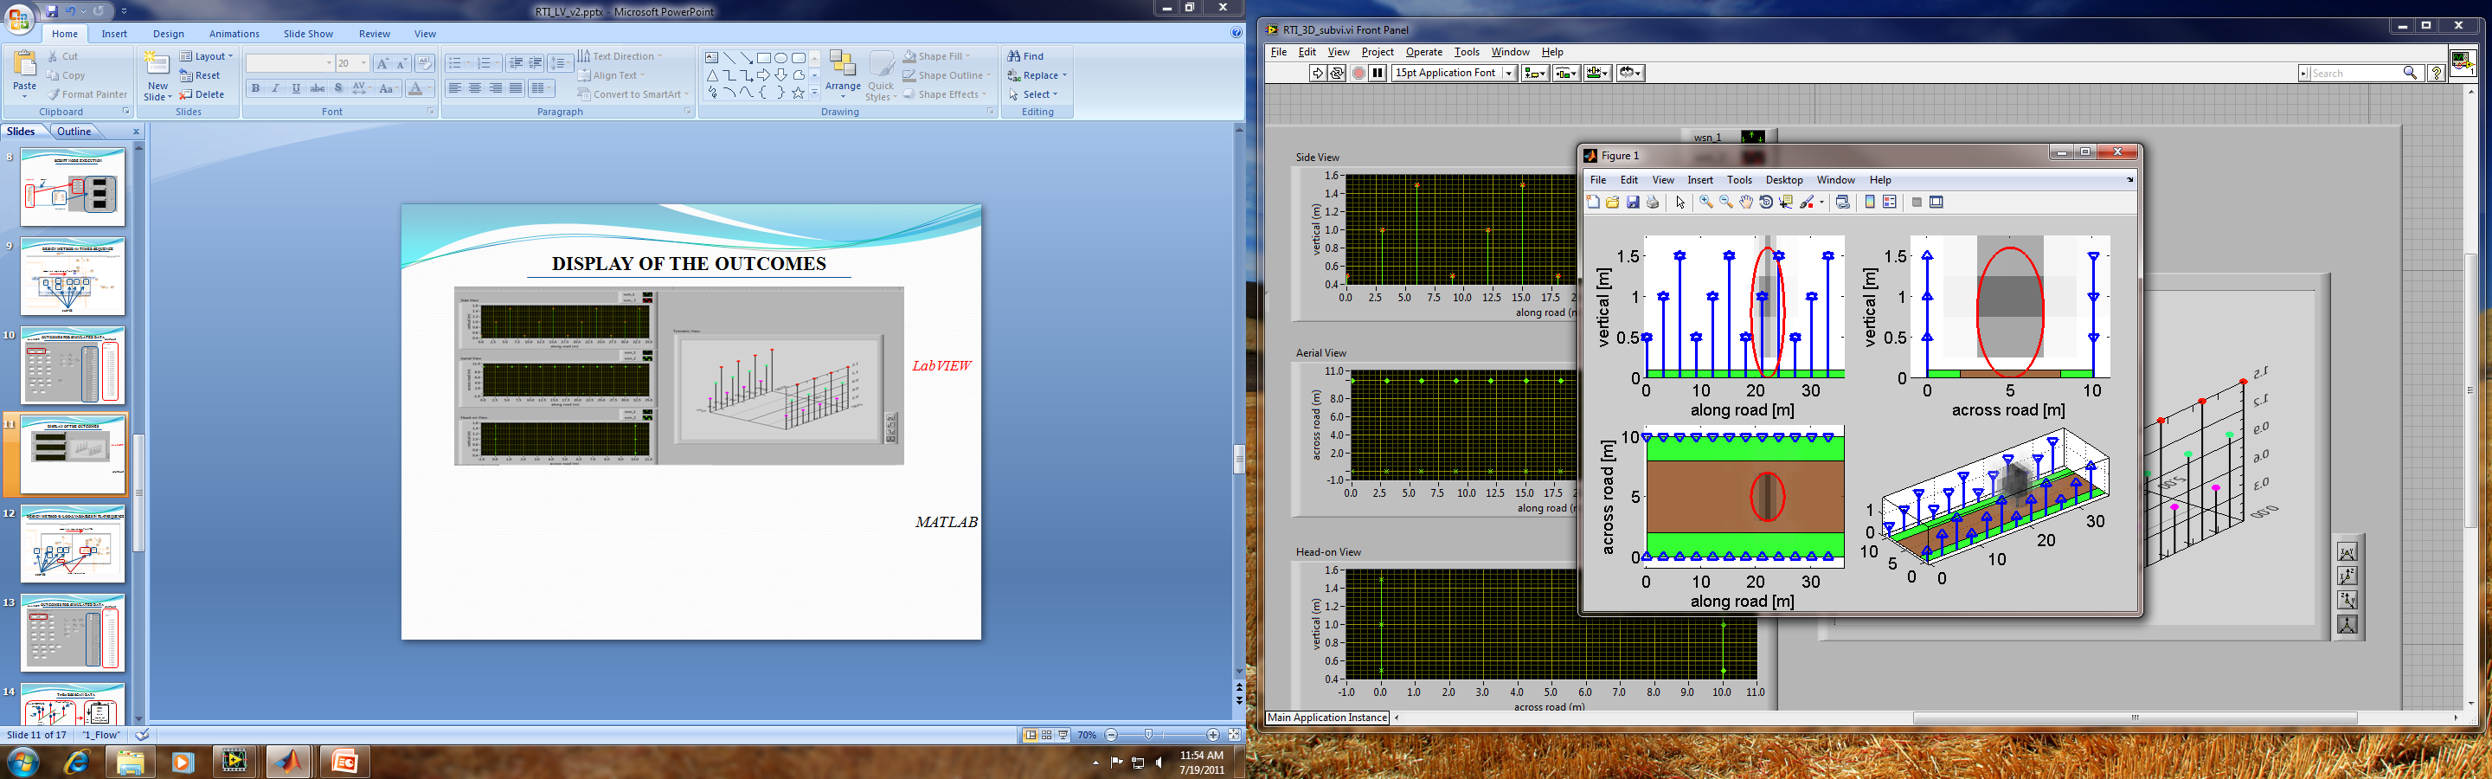

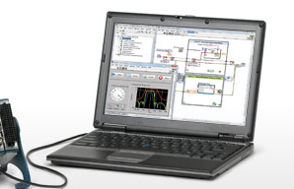
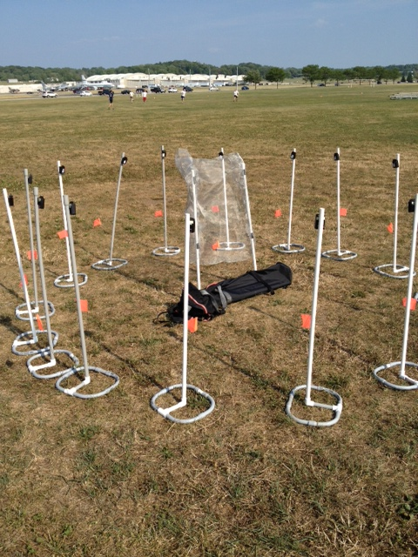
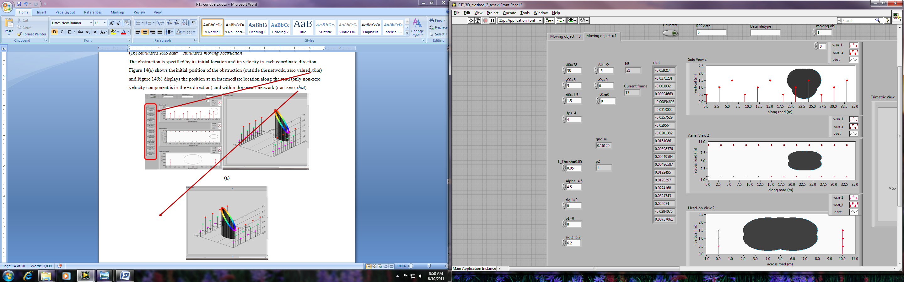

Overview:
Wireless Sensor Network
Mobile RTI Interface
Information Display
Rectangular
Circular
Stage 1
Objectives:
Form a Wireless Sensor Network;
Program one Telosb Mote as Base Station to collect data;
Program other Telosb Motes as transmitters and receivers;
Tabulate the data(Signal strength).

Slide 3
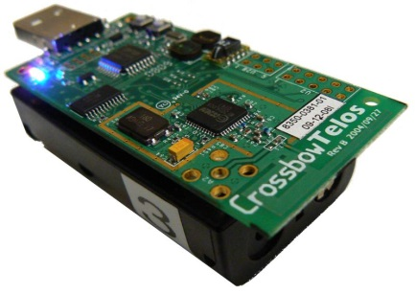

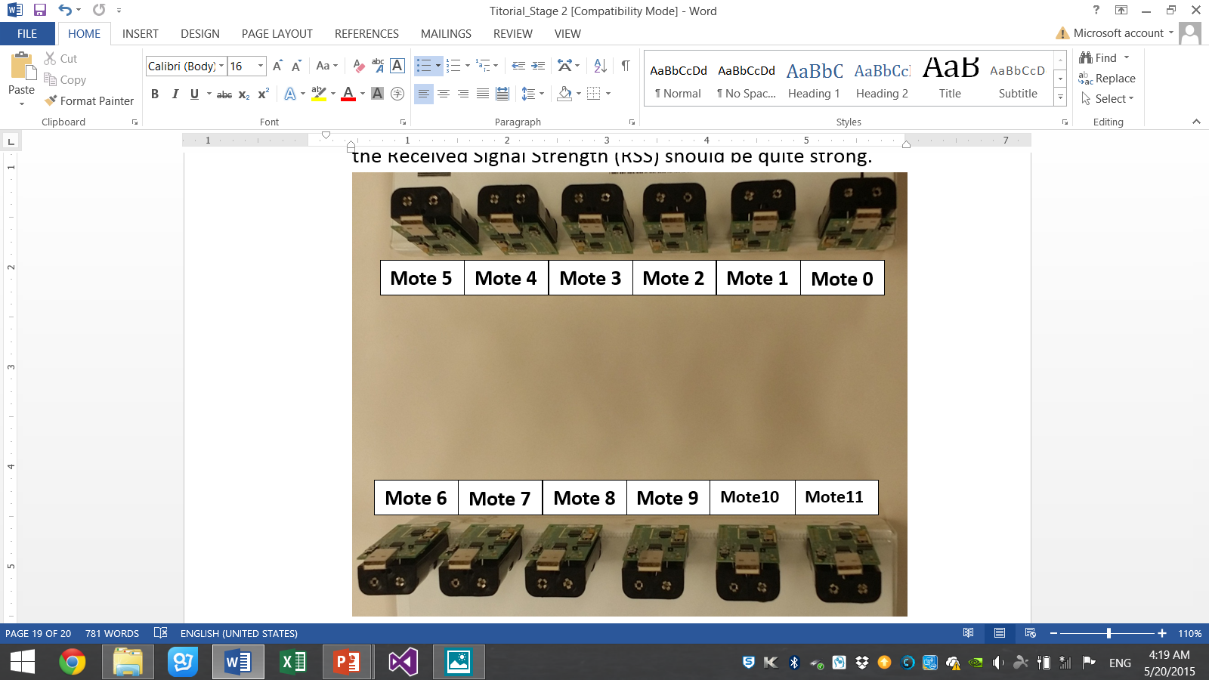
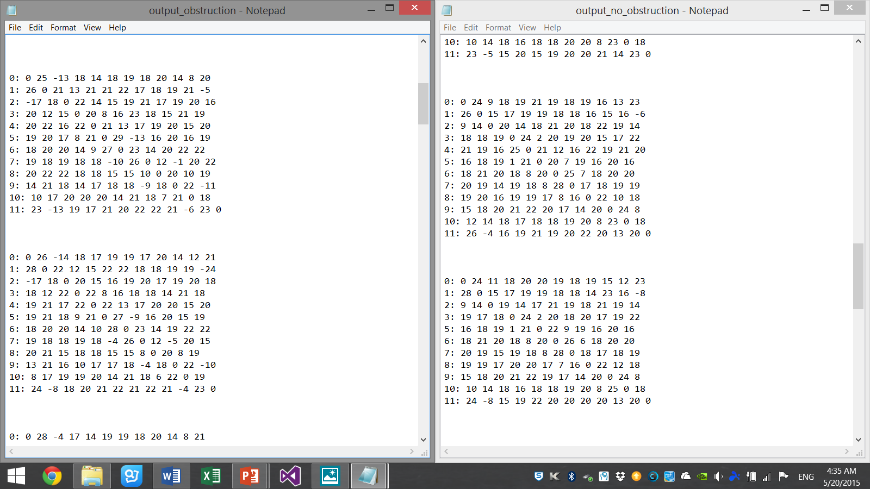
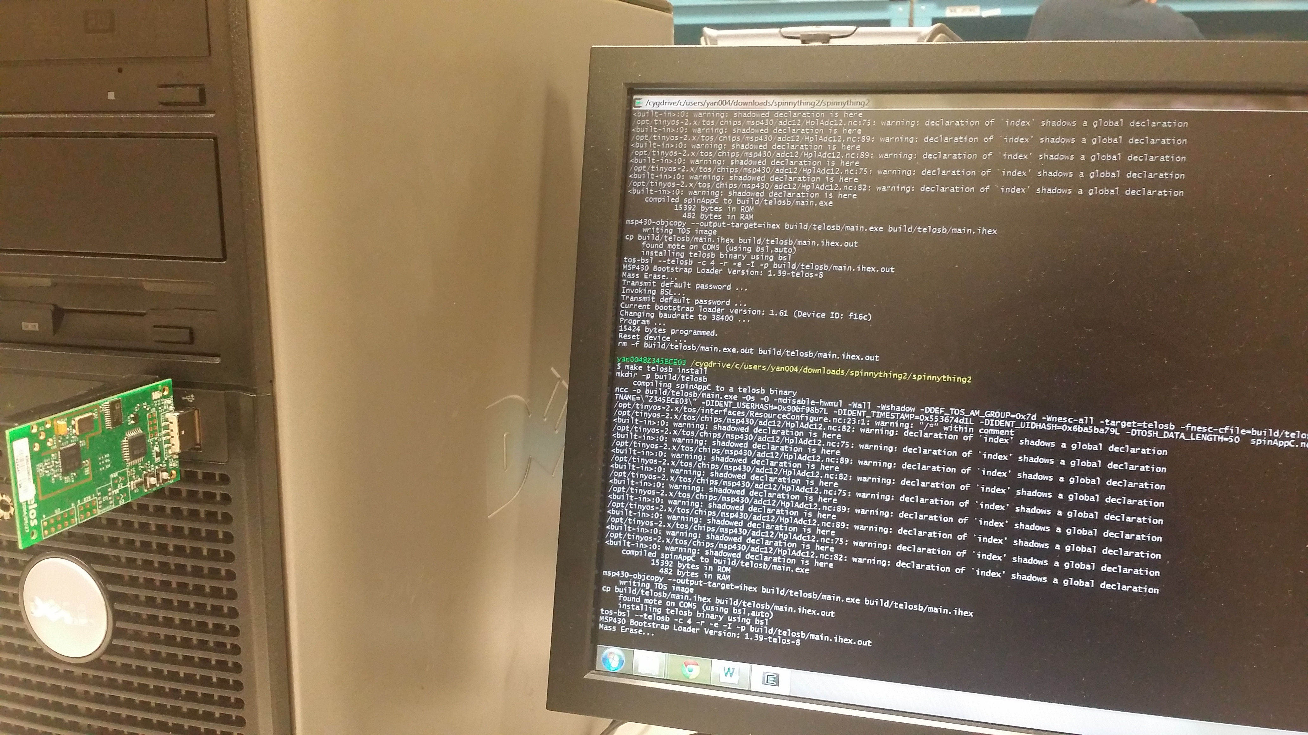
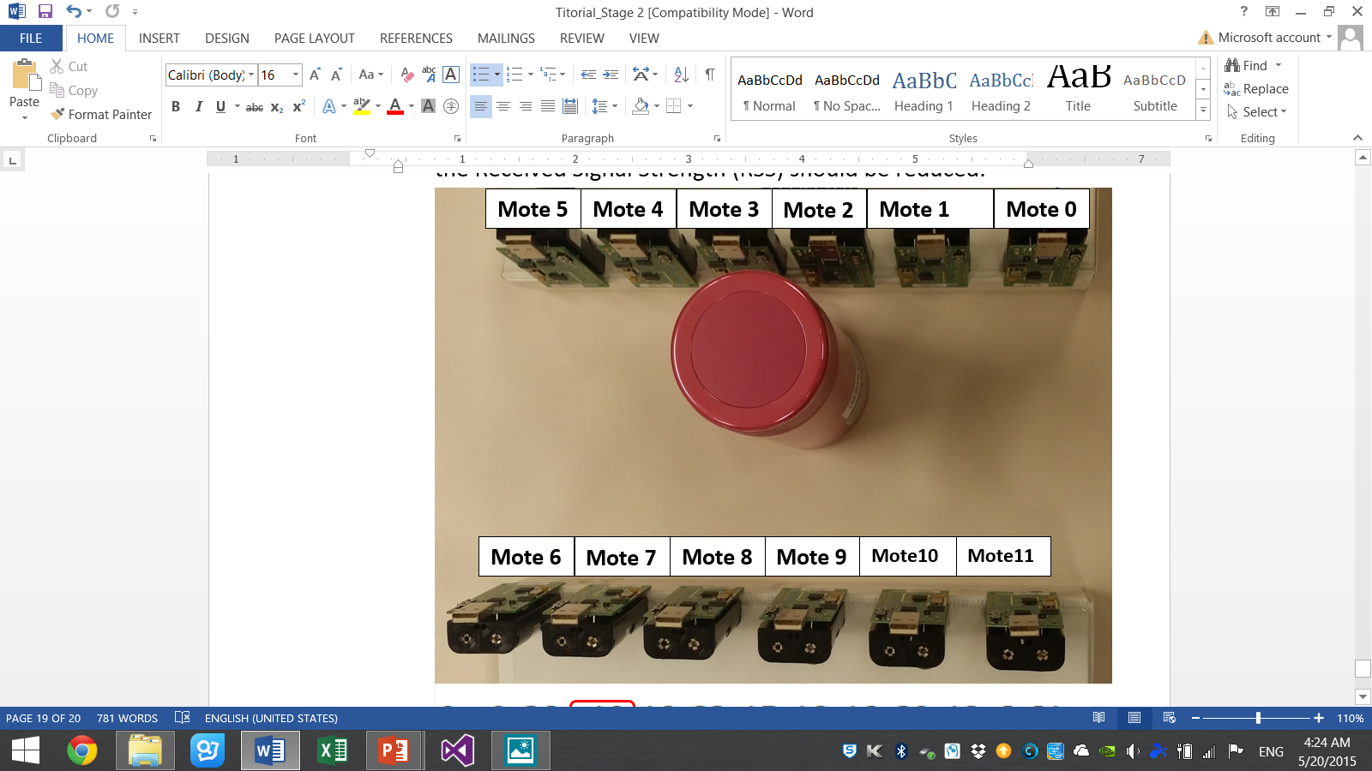
DEVICES AND SKILLS REQUIRED:
Main Devices: Telosb Mote
Programming language: Java & TinyOS (NesC)
Interface terminal: Cygwin Terminal
Testing and result:
Base Station

Slide 4
What did I DO:
Completed 3 Tutorials (Tutorial 1.1, Tutorial 1.2 & Tutorial 2.1)
Wrote Java program for rearranging output to matrix format
Tested the program in different size of the network
Troubleshooting with my teammates
Completed the reliability test in lab and analyzed them.
WHAT DID I LEARN:
Academic:
3 programming language: Java, TinyOS (NesC) and Labview
Telosb motes
Others:
Team work
Independent troubleshooting

Slide 5
Conclusion and future work:
Conclusion: | Future Work:
Completed the first stage – Data Collection | Pass all the data to second stage to do picture imaging
Lab Testing is completed | Test in field and outside environment
Thank you !

